Slide 1
Paraphrasing

Slide 2
Paraphrasing is taking something complicated and unclear and restating it in simpler or more understandable terms.
when you want your readers to understand all of its points
when you are unsure of its meaning. Rewording a complex writing into simple terms may help you better understand the content and purpose of the passage
when you want to avoid Plagiarism

Slide 3
Do Include all important ideas mentioned in the original passage.
Do Keep the length approximately the same as the original.
Do not stress any single point more than another.
Do not change the meaning by adding your own thoughts or views.
Do not use the original sentence structure or order.
Use synonyms for all words that are not generic.
Change the structure of the sentence.
Change the voice from active to passive and vice versa.
Change clauses to phrases and vice versa.
Change parts of speech.

Slide 4
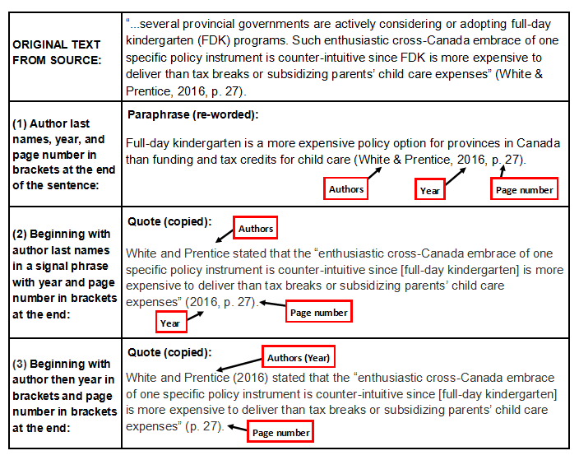

Slide 5
Media plays crucial role in shaping minds and opinions of masses. For disaster management all kinds of media including print, electronic, social and digital media be taken on board timely. As during any kind of catastrophe, communication channels are the first to be erupted hence the group of trained volunteers be present everywhere to reach timely and ease out people in trouble. Media while remaining objective and progressive must address challenges in the wake of climate change or other human instigated incidents and bring positive improvement in entire spectrum including all vulnerable groups (children, women, aged and disabled). During any mishap, it becomes our social responsibility to facilitate people instead of portraying it as a spicy story while deviating from the norms of civilized society. (Reema Shakuat, A Resilient Nation, 8th October, 2018)

Slide 6
Paraphrasing Rubric (15)
Criterion | Exceeds Expectations | Meets Expectations | Below Expectations
Points earned | 3 | 2 | 1
Main Idea | Main idea is clear | Main idea is hinted on | Main idea is incorrect
Detail | Relevant detail included | Some relevant detail missing | Too many or no details
Paraphrase | sentence and word order changed | Some sentences put into own words | Sentence copied from text
Grammar | Sentence structure is varied | Sentence structure is simple | No change in Sentence structure
Spelling /punctuation | 1.5 No spelling/ punctuation errors | 1.0 some spelling/ punctuation errors | 0.5 Many spelling/ punctuation errors
References | 1.5 Accurate use | 1.0 Partly accurate use | 0.5 Incorrect/missing references

